Slide 1
Unit C
Organizing
3.1 Meaning, Importance and Principles
3.2 Departmentalization, Span of Control
3.3 Authority, Delegation of Authority.

Slide 2
Organisation Structure
An organisation structure is a set of planned relationships between groups of related functions and between physical factors and personnel required for the performance of the functions.
The organisation structure is generally shown in the form of an organisation chart.
It shows the authority and responsibility relationships between the various positions in the enterprise by showing who reports to whom.

Slide 3
Importance of Organisation Structure
Facilitates Administration
Promotes growth and diversification
Co-ordination
Optimum Use of Human Resources
Training and Development

Slide 4
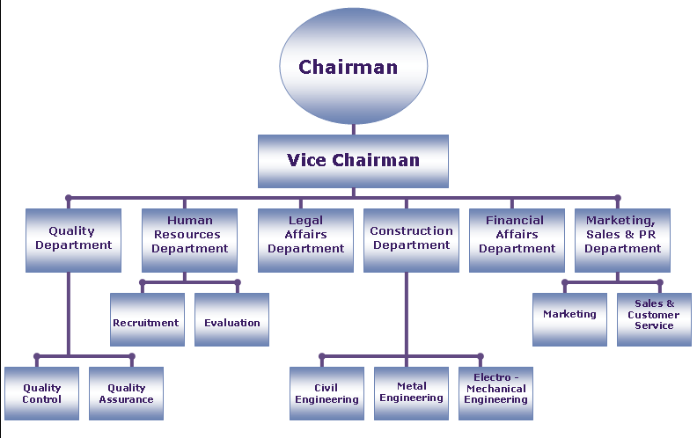
The Organisational Chart

Slide 5
Types of Organization structure
There can be two types of organization structure on the basis of span of control and scalar chain:
Flat structure
Tall structure

Slide 6
Flat Organizational Structure- Horizontal
Characteristic of decentralized companies with relatively few layers of management and relatively wide spans of control
Typical Law Firm
Chief Partner
Partners
Associates
Relatively wide span of control

Slide 7
Tall Organizational Structure-Vertical
Army
General
Brigadier
Characteristic of centralized companies with multiple layers of management and relatively narrow spans of control
Colonel
Major
Captains & Lieutenants
Relatively narrow span of control.
Subedar Major
At lower levels, where tasks are similar and simpler, span of control widens.
Naik
Soldier
5 - 7

Slide 8
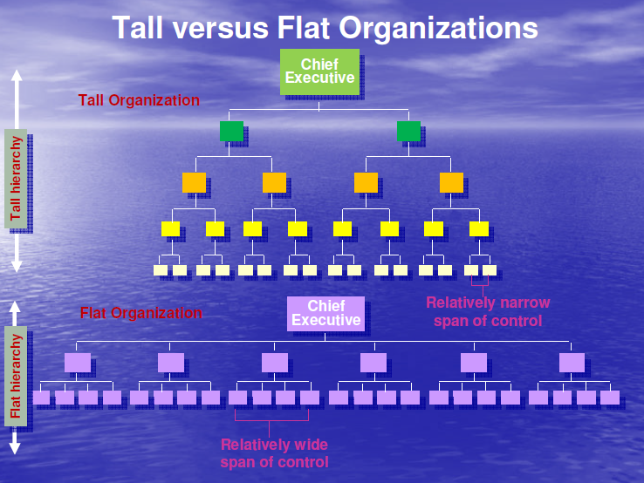

Slide 9
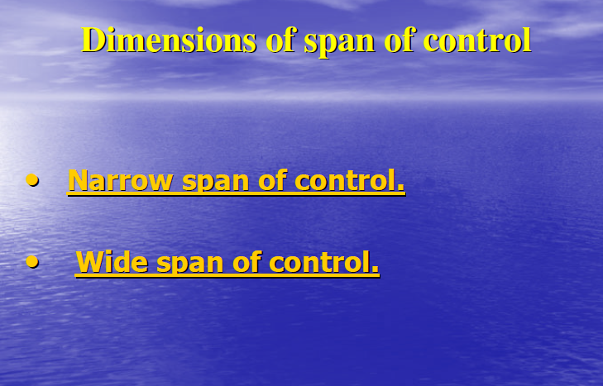

Slide 10
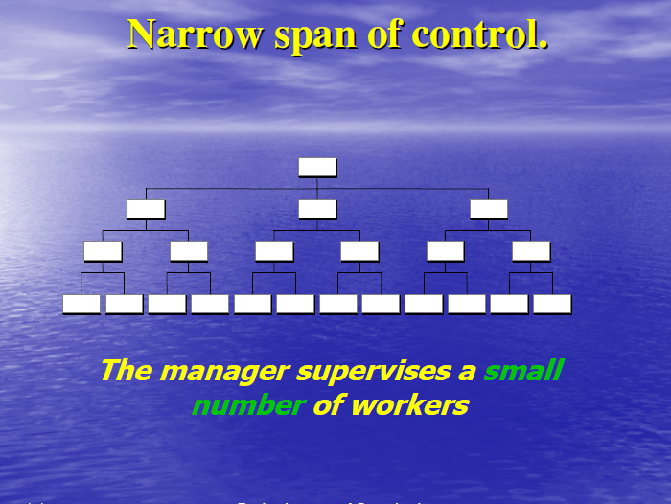

Slide 11
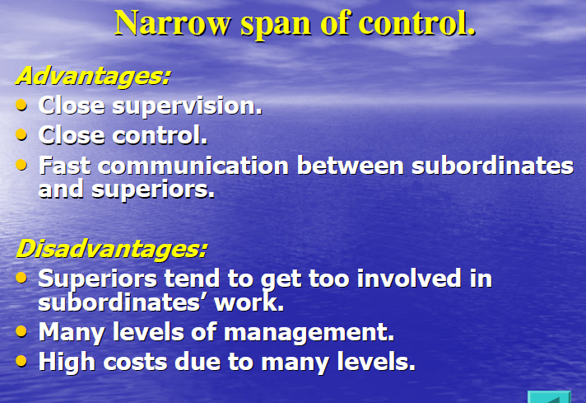

Slide 12
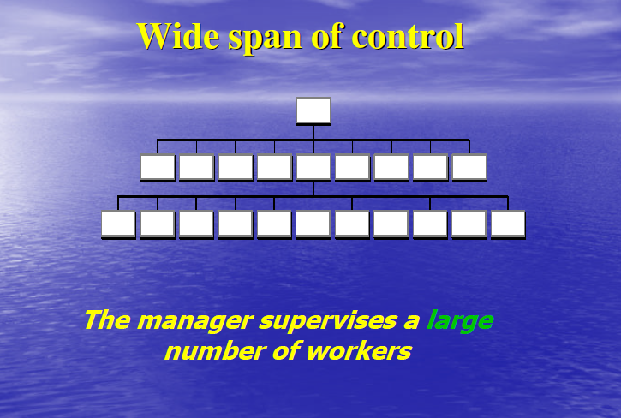

Slide 13
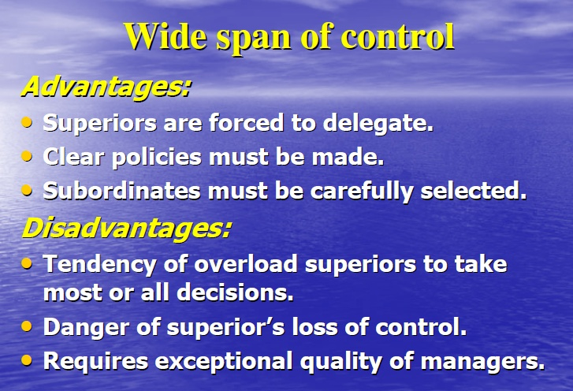

Slide 14
Principle of Span of Control
According to this principle, a manager would be able to handle what number of employees under him should be decided. This decision can be taken by choosing either from wide or narrow span. There are two types of span of control:-
Wide span of control-
Narrow span of control

Slide 15
Span of Management/ Span of Control
Number of employees who report to a supervisor
number of employees that a manager can efficiently and
effectively manage
determines the number of levels and managers in an
organization
the wider the span, the more efficient the organization
appropriate span influenced by:
• the skills and abilities of employees
• the complexity of tasks performed
• availability of standardized procedures
• sophistication of organization’s information system

Slide 16
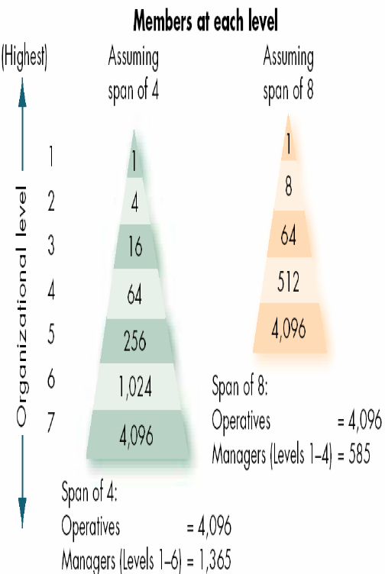

Slide 17
Factors influencing Span of Control
Managerial abilities- In the concerns where managers are capable, qualified and experienced, wide span of control is always helpful.
Competence of subordinates- Where the subordinates are capable and competent and their understanding levels are proper, the subordinates tend to very frequently visit the superiors for solving their problems. In such cases, the manager can handle large number of employees. Hence wide span is suitable.
Nature of work- If the work is of repetitive nature, wide span of supervision is more helpful. On the other hand, if work requires mental skill or craftsmanship, tight control and supervision is required in which narrow span is more helpful.

Slide 18
Factors influencing Span of Control
Delegation of authority- When the work is delegated to lower levels in an efficient and proper way, confusions are less and congeniality of the environment can be maintained. In such cases, wide span of control is suitable and the supervisors can manage and control large number of sub- ordinates at one time.
Degree of decentralization- Decentralization is done in order to achieve specialization in which authority is shared by many people and managers at different levels. In such cases, a tall structure is helpful. There are certain concerns where decentralization is done in very effective way which results in direct and personal communication between superiors and sub- ordinates and there the superiors can manage large number of subordinates very easily. In such cases, wide span again helps.

Slide 19
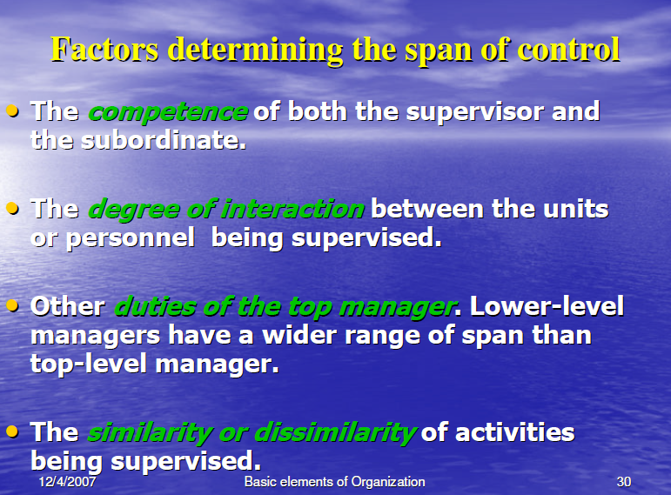

Slide 20
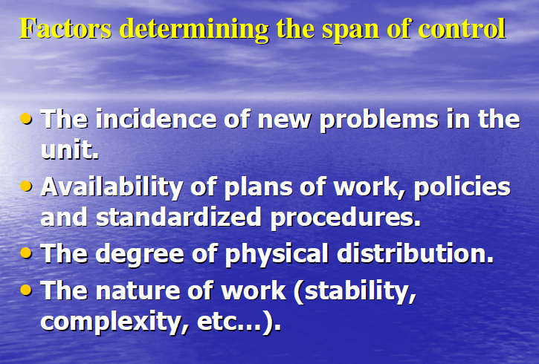

Slide 21
Departmentalisation
A work group brought together for performing certain functions of similar nature.
Departments are the various parts or divisions of an enterprise.
It is the process of division of enterprise into different parts known as departments. It helps in simplifying the task of top management.

Slide 22
Advantages of Departmentation
Advantages
Specialization
Appraisal
Training of Executives
Control
Increased Efficiency
Fixation of Responsibility

Slide 23
Departmentalisation
Types of Departmentation
Functional
Project
Matrix
Network
Product
Customers
Geographical area
Process

Slide 24
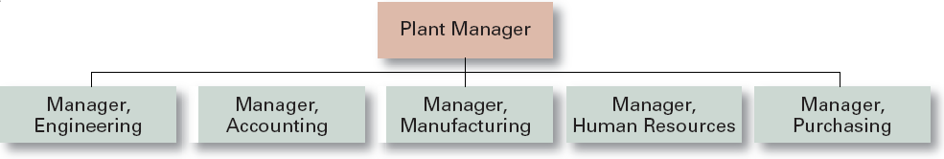
Functional Structure
In a functional structure, activities are grouped and departments are created on the basis of specified functions to be performed.
It is useful where specialization is required in the performance of various functions like production, finance, marketing, etc.

Slide 25
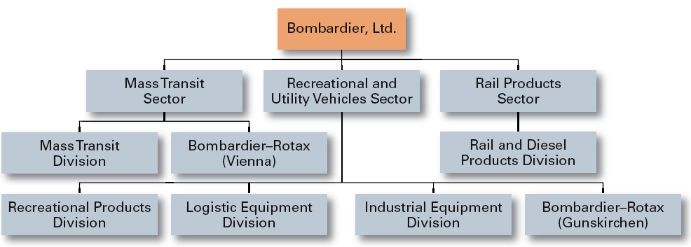
Product/Divisional Structure
Such type of structure is adopted by organisations having multiple product lines. Each major product or product line is organized as a separate division.
It is appropriate when each product is relatively complex and a great deal of capital is required for each product.

Slide 26

Divisional Organization
Organizational structure in which corporate divisions operate as autonomous businesses under the larger corporate umbrella
HEINZ
Food Service Division
Infant Foods Division
Condiments Division
Star-Kist Tuna Division
Pet Foods Division
Frozen-Foods Division
Misc. Products Division
Division: Department that resembles a separate business in producing and marketing its own products.

Slide 27
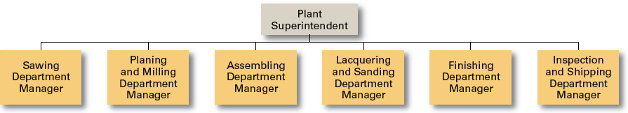
Process Departmentalization
More efficient flow of work activities
Can only be used with certain types of products

Slide 28
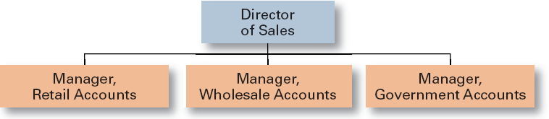
Customer Departmentalization
Followed in enterprises engaged in providing specialized services to different classes of customers.
Customers are the guide for grouping the activities.

Slide 29
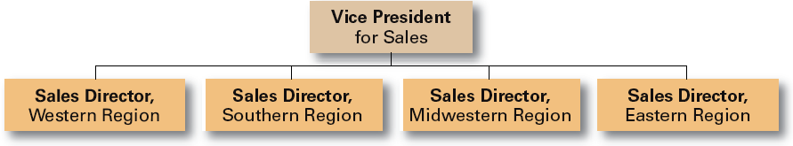
Geographical/International Departmentalization
It is followed in case of service organizations which have offices in different regions or geographical areas.

Slide 30
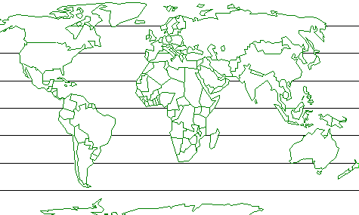
International Organization
Approaches to organizational structure developed in response to the need to manufacture, purchase, and sell in global markets.
CEO
Retail Division A
Retail Division B
International Division
Latin America
Europe
Asia

Slide 31
Project Departmentalization
A project may be defined as a complex set of activities which are diverse, specialized and technical to be performed within the given time frame and cost structure.
The project staff is separate from and independent of the functional departments.
This would be for a company that does projects as a main part of their business, most resources are involved in project work. Since the project lead has the team reporting to him/her, he/she has a lot of authority. At the end of the project, the team members are reassigned.

Slide 32
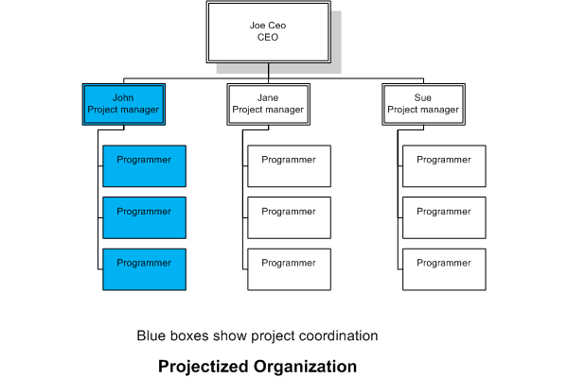

Slide 33
Matrix Organization
It is also called as grid organization, it is a hybrid structure combining functional departmentation with project structure.
A matrix is a highly flexible form that is readily adaptable to changing circumstances.
Matrix structures rely heavily on committee and team authority.
Some companies use the matrix organization as a temporary measure to complete a specific project. The end of the project usually means the end of the matrix.

Slide 34
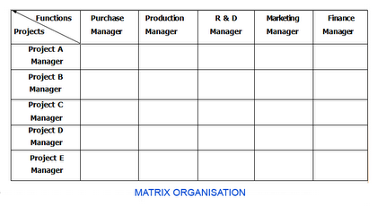

Slide 35
Network/Virtual Organization
It is a flexible, usually temporary set of alliances among disparate companies that have come together for a specific, single purpose.
It allows organizations to focus on that which they do best i.e., their core competence.
In this way organizations can discontinue activities not part of its core and may outsource such functions from other firms.

Slide 36
Network/Virtual Organization
Contracted Manufacturing in Asia
Contracted Administrative Services
Accounting
Human Resources
Core Organization
Finance
Operations
Management
Contracted Sales & Marketing
Contracted Distribution & Logistics
6 - 36

